Slide 1
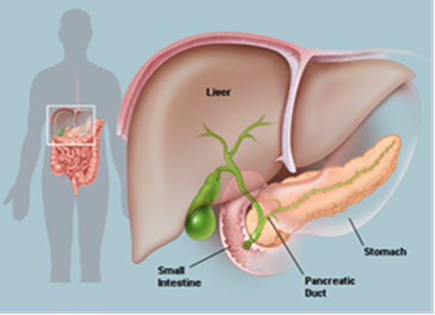
Diabetes in the Mentally Ill
MO Coalition Conference 2011

Slide 2
What you need to be familiar with:
Definition of diabetes
Risk factors
Common symptoms
Screening
Management
Preventing complications
Special considerations

Slide 3
What is Diabetes?
Inability to regulate blood glucose
Associated with significant health risks
Blindness
Kidney disease
Heart disease
Stroke
Amputation (neuropathy and vascular disease)
Susceptibility to infection
Poor wound healing

Slide 4
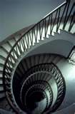
Insulin Resistance
Body produces insulin, but does not use it properly
Cells do not respond properly to insulin
Pancreas fails to keep up , excess glucose builds up in the bloodstream
Increases chance of Type 2 diabetes and heart disease

Slide 5
Laboratory Definitions
Random glucose > 200 mg/dL OR
Fasting glucose > 125 mg/dL OR
Positive glucose tolerance test
After fasting subject is given 75 gm of glucose
2 hour glucose > 200 mg/dL
“Impaired” glucose tolerance test
2 hour glucose 140 – 200 mg/dL

Slide 6
Types of Diabetes
Type 1: a disorder of the body ’s immune system
Type 2: adult-onset diabetes
Gestational diabetes: glucose intolerance related to pregnancy
Prediabetes: Hyperglycemia not sufficient to meet diagnostic criteria for diabetes,
Is risk factor for future diabetes
Lily- Diabetes Fundamentals

Slide 7
Diabetes and Children
Type 1 diabetes was formerly referred to as juvenile diabetes
One in every 400-600 children has type 1 diabetes
Type 2 diabetes in children is on the rise due to the childhood obesity epidemic
Managing diabetes in children- there are several special things to consider

Slide 8
Why? Diabetes Prevalence
Epidemic of Diabetes 60% Increase in Diagnosed Diabetes in One Decade¹
Prevalence of Diagnosed Diabetes Among US Adults, 1990
Prevalence of Diagnosed Diabetes Among US Adults, 2001
No Data | <4% | 4-6% | 7-8% | 9-10% | >10%
Mokdad AH, et al. JAMA . 2003;289(1):76-79.

Slide 9
How Big is the Problem?
MO Diabetes Prevalence for 2008 was 8.6% up from 6.4% for 2000.
MO Obesity Rate for 2008 was 28.5%
Persons with serious mental illness are now dying 25 years earlier than the general population. Their increased mortality and morbidity are largely due to treatable medical conditions that are caused by modifiable risk factors.
Persons with schizophrenia are 2-4 more likely to develop diabetes.

Slide 10
Natural History of Type 2 Diabetes
Uncontrolled
Obesity IGT Diabetes Hyperglycemia
Plasma
Glucose
126 (mg/dL)
Relative β-Cell Function
Insulin Resistance
100 (%)
Insulin Level
-20
-10
0
10
20
30
IGT = impaired glucose tolerance.
Years of Diabetes
Adapted from: International Diabetes Center (IDC). Available at: www.parknicollet.com/diabetes/disease/diagnosing.cfm. Accessed March 26, 2006.

Slide 11
Prevalence of Diabetic Tissue Damage at Diagnosis of Type 2 Diabetes
Prevalence
Dagogo-Jack et al. Arch Int Med. 1997;157:1802-1817.

Slide 12
Macro-vascular disease
Macro-vascular disease includes stroke, myocardial infarction, and claudication
97% of diabetics have abnormal cholesterol
Annual fasting lipid study
Hypertension can exacerbate vascular disease
Manage blood pressure closely

Slide 13
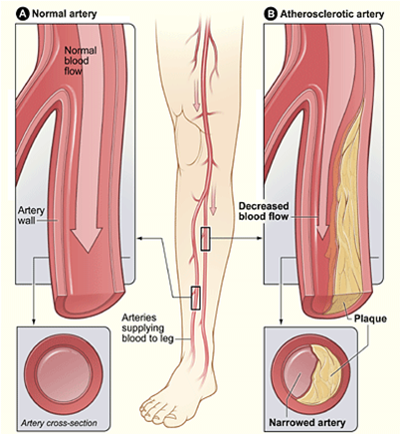
Micro-vascular Disease
Kidney Disease
Annual blood creatinine and urinary albumin
Peripheral neuropathy
Results in decreased sensation in extremities
Increased risk of injury to feet
Leading cause of amputation
Annual foot exam
Diabetic Retinopathy
Leading cause of blindness in US
Annual diabetic eye exam
Other micro-vascluar complications
Gastroparesis
Erectile dysfunction

Slide 14
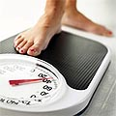
Screening
Evaluate risk factors regularly
BMI- body mass index,
Blood pressure
Annual fasting glucose & lipid panel

Slide 15
Common Symptoms
Unexplained, rapid weight loss
Blurred vision
Weakness and extreme fatigue
Irritability
Dry, itchy skin
Infections or slow healing wounds
Sweet-smelling breath
Consumers often do not view these symptoms as serious

Slide 16
Management of Diabetes
Lifestyle – meal planning, exercise
Nutritional counseling or groups
Glucose monitoring
Urine monitoring for ketones
Hemoglobin A1c
Indicates average amount of glucose exposure over past 3 months
Should be below 6.1 %
If greater than 8% → diabetes is not adequately controlled!

Slide 17
ABCs of Diabetes Management
Criteria |  | Optimal Targets
 |  | ACE^{*1} | ADA^{†2}
A | A1C | <6.5% | <7.0%
 | Preprandial/fasting blood glucose | <110 mg/dL | 90-130 mg/dL
 | Postprandial/2-h blood glucose | <140 mg/dL | <180 mg/dL
B | Blood pressure |  | <130/80mmHg
C | Cholesterol | ATP III^{‡3} | ADA^{†2}
 | LDL | <100 mg/dL | <100 mg/dL
 | Triglycerides | <150 mg/dL | <150 mg/dL
 | HDL | § | >40 mg/dL
ADA. DACE. Endocr Pract. 2002;8(Suppl 1):5-11.
iabetes Care. 2006;29(Suppl 1):S3-S37.
NCEP. ATP III. JAMA. 2001;285(19):2486-2497.
*American College of Endocrinology
†American Diabetes Association
‡Adult Treatment Panel III
§ATP III does not specify a goal for raising HDL

Slide 18
Basic tools for Diagnosing Diabetes Casual plasma glucose test Fasting plasma glucose test (FPG) Oral plasma glucose test (OGTT)
Diabetes range following the FPG
Diabetes
>126 mg/dl
Diabetes
>200 mg/dl
Diabetes range following the OGTT
Pre-diabetes range following the FPG=impaired fasting glucose (IFG)
<126 mg/dl
>100 mg/dl
<200 mg/dl
>140 mg/dl
Pre-diabetes range following the OGTT=impaired glucose (IGT)
<100 mg/dl
<<140 mg/dl
Normal range following the FPG
Normal range following the OGTT

Slide 19
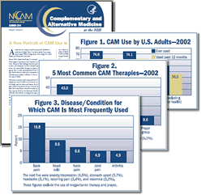
Diabetes Self-Management Education (DSME)
Appropriate components of diabetes care
Self-monitoring of blood glucose
Record keeping
Appropriate nutrition
Weight management
Physical activity

Slide 20
Self-Monitored Blood Glucose (SMBG)
SMBG is a key component of intervention that can improve glycemic control
Steps to assist your patient with SMBG
Advise patient to keep a written log
Demonstrate how to look for patterns and when to test blood glucose
Describe the importance of working with the diabetes care team
Advise patients to store and dispose of equipment properly

Slide 21
Hyperglycemia
Hyperglycemia causes include:
Poor food choices
Missed medication
Stress or illness
Missed exercise
Hyperglycemia increases the risk of other more serious, short-term complications.

Slide 22
Symptoms of Hyperglycemia (high blood sugar)
Excess urine production (polyuria)
the body is trying to get rid of excess sugar
Excess thirst (polydipsia)
the more your body urinates the thirstier you become
Increased hunger (polyphagia)
the cells are not being fed & are hungry
Weight loss~ your body burns fat for energy
Itching ~ dehydration causes dry skin and itching
Confusion~ lack of glucose to brain cells causes confusion

Slide 23
Complications – Diabetic Ketoacidosis (DKA)
Occurs with high glucose (>500 mg/dL)
Often associated with underlying infection, missed insulin treatment, or undiagnosed diabetes
Rapid onset of:
Weight loss, nausea/vomiting, dehydration, polyuria, polydipsia, confusion, rapid respiration
DKA is a medical emergency!
Hospitalization for aggressive IV hydration, insulin therapy, and correction of metabolic abnormalities

Slide 24
Oral Diabetes Medications

Slide 25
Hypoglycemia
Hypoglycemia, or low blood sugar, is a common short-term complication of medication therapy in diabetes management. It must be recognized and treated quickly.
May occur if an individual:
Skips a meal
Takes too much medication
Exercises more than usual

Slide 26
Hypoglycemia Prevention
Do not skip meals
Take measures to prevent nocturnal hypoglycemia
Always carry 30 grams of carbohydrates or glucose
Monitor blood glucose regularly
Exercise with a buddy
Take medication as suggested

Slide 27
Hypoglycemia Treatment
Take PROMPTaction
Hypoglycemia is defined as <70 mg/dl
Eat or drink some form of carbohydrates (15 grams)
If you still have symptoms 10 to 15 minutes after eating or drinking repeat these steps until your sugar is above 70 or until you feel better.
Eat a meal with the next hour
Sometimes hypoglycemia will present with more sever symptoms, such as loss of consciousness

Slide 28
Rule of 15 15 gram of carbohydrate every 15 minutes
The following items contain 15 grams of carbohydrate:
2 to 5 glucose tablets
1/2 cup (4 oz) fruit juice
1/2 cup (4 oz) regular (not diet) soda (about half a can)
6 to 8 ounces of skim milk
1/4 to 1/3 cup of raisins
5 to 7 pieces of hard candy like Lifesavers
a tube of glucose in gel form (such as InstaGel or MonGel)
1 tablespoon of molasses, corn syrup, or honey.

Slide 29
Medications Require Lab Monitoring
Thiazolidinedione (Avandia, Actos)
Liver function tests
Metformin (Glucophage)
Renal function (creatinine)
Sulfonylureas (Amaryl, Glucotrol)
Can cause hypoglycemia

Slide 30
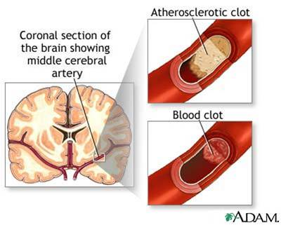
Prevention of Complications
Diabetics are more susceptible to infections
Time to recovery is longer
Offer pneumovax every 6 years
Annual influenza vaccine
Screen for vascular disease
Micro-vascular (small vessels)
Macro-vascular (large vessels)

Slide 31
Mental Illness and Diabetes
The Mentally Ill have a higher rates of diabetes
Contributing risk factors
Lifestyle
Poor nutrition Lack of exercise
Obesity- central adiposity
Medical factors – hypertension, triglycerides, HDL
Family history
Ethnicity (Native American, African American, Hispanic, Asian)
Poor medical follow-up
Increased medical complications
Decreased life expectancy

Slide 32
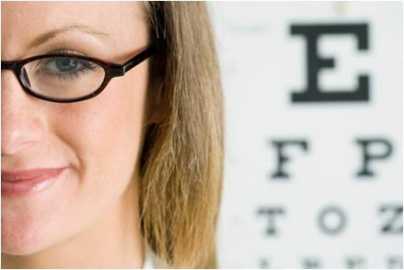
Managing Risk
Consider risks of atypicals
Consumer, family and caregiver education
Baseline screening
Regular monitoring
Use of specialized services when needed
Nutritional counseling
Diabetes education group
Medical specialists

Slide 33
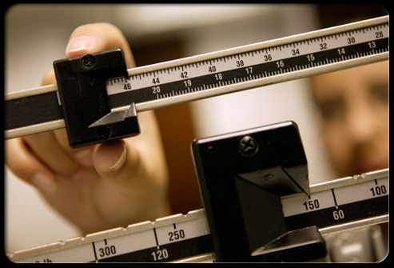
Using Atypical Antipsychotics
Pre-treatment evaluation
BMI
Waist circumference
Fasting glucose and lipids
Monitor weight every month for
3 months and then quarterly
thereafter
Waist circumference annually
Fasting lipids and glucose after
3 months then annually

Slide 34
ADA/APA/AACE/NAASO Consensus Conference on Antipsychotic Drugs and Risk of Obesity and Diabetes
Drug | Weight Gain | Diabetes Risk | Dyslipidemia
clozapine | + + + | + | +
olanzapine | + + + | + | +
risperidone | + + | D | D
quetiapine | + + | D | D
aripiprazole | +/- | - | -
ziprasidone | +/- | - | -
+ = increased effect; - = no effect; D = discrepant results.
Diabetes Care. 2004;27:596-601.

Slide 35
1-Year Weight Gain: Mean Change From Baseline Weight
14
Olanzapine (12.5–17.5 mg)
Olanzapine (all doses)
Quetiapine
Risperidone
Ziprasidone
Aripiprazole
30
12
25
10
20
8
15
6
Change From Baseline Weight (lb)
4
10
2
5
0
0
0
4
8
12
16
20
24
28
32
36
40
44
48
52
Nemeroff CB. J Clin Psychiatry. 1997;58(suppl 10):45-49; Kinon BJ et al. J Clin Psychiatry. 2001;62:92-100; Brecher M et al. American College of Neuropsychopharmacology; 2004. Poster 114; Brecher M et al. Neuropsychopharmacology. 2004;29(suppl 1):S109; Geodon® [package insert]. New York, NY:Pfizer Inc; 2005. Risperdal® [package insert]. Titusville, NJ: Janssen Pharmaceutica Products, LP; 2003; Abilify® [package insert]. Princeton NJ: Bristol-Myers Squibb Company and Rockville, Md: Otsuka America Pharmaceutical, Inc.; 2005.

Slide 36
CATIE Trial Results: Weight Gain Per Month Treatment
Weight gain (lb) per month
NEJM 2005 353:1209-1223

Slide 37
ADA/APA/AACE/NAASO Consensus Recommendations on Responding to Antipsychotic-associated Metabolic Changes
If weight gain is ≥ 5% of body weight, consider interventions, including switching to another second generation antipsychotic
If glycemia or dyslipidemia worsen, consider switch to an second generation antipsychotic not associated with significant weight gain or diabetes
Gradually discontinue/cross-titrate
Closely monitor psychiatric symptoms during changeover
American Diabetes Association. Diabetes Care. 2004;27:596-601.

Slide 38
Change in Weight From Baseline 58 Weeks After Switch to Low Weight Gain Agent
Weiden P et al. Presented APA 2004.

Slide 39
Medical Nutrition Therapy
Goal to decease body weight by 5-10%
Increase physical activity
Pharmacologic treatment
Physically active individuals have lower risk of mortality in comparison to physically inactivity individuals, independent of adiposity
Managing Pre-diabetes

Slide 40
Meyer et al., Presented at APA annual meeting, May 21-26, 2005.
McEvoy JP et al. Schizophr Res. 2005;80:19-32.

Slide 41
Weight and Diabetes are closely related!
Mokdad et al. Diabetes Care. 2000;23:1278; Mokdad et al. JAMA. 1999;282:1519; Mokdad et al. JAMA. 2001;286:1195.

Slide 42
Natural History of Type 2 Diabetes
Uncontrolled
Obesity IGT Diabetes Hyperglycemia
Plasma
Glucose
126 (mg/dL)
Relative β-Cell Function
Insulin Resistance
Insulin Level
-20
-10
0
10
20
30
IGT = impaired glucose tolerance.
Years of Diabetes
Adapted from: International Diabetes Center (IDC). Available at: www.parknicollet.com/diabetes/disease/diagnosing.cfm. Accessed March 26, 2006.

Slide 43
Prevalence of Diabetic Tissue Damage at Diagnosis of Type 2 Diabetes
Prevalence
Dagogo-Jack et al. Arch Int Med. 1997;157:1802-1817.

Slide 44
Is this DMH Net or DM 3700?
Questions?

